Slide 1
Greetings RPCV!
This is a customizable PowerPoint that can be used for a presentation of your service. This template is meant for a range of 6-12th grade audiences, though it could be adjusted for younger learners or college age. Please customize each slide with any pictures you would like to share, and feel free to edit or delete any information or slides you do not want. Be sure to check the notes section below each slide for tips, links and guidance.
There are endless ways to present your Peace Corps service and country.
This presentation follows chronologically with your service. However, feel free to be creative in how you organize the presentation flow.
Feel free to email us at wwsinfo@peacecorps.gov with any questions, or just to share highlights from your Third Goal activity. We wish you the best of luck in your presentation!
Thank you for your sharing your country of service!
**Delete this slide before presenting**

Slide 2
Country of Service
DESIGN TIP:
Do you want to modernize your presentation?
It is best practice to use the 9x16 widescreen template to fill the screen and maximize presentation space.
DESIGN TIP:
Do you want to change this image?
The background image on this slide is located on the Slide Master Page.
The Peace Corps has provided a selection of Title Slide images to choose from.
Select “Slide Master” from the “View” tab menu at the top of your screen and choose from one of the options provided.
Name
Date of Service
Notes:
This is the slide for context. Introduce yourself and give your audience a little bit of background (throw in a local greeting to spark interest).
Interactive idea: Maybe ask them what they already know about Peace Corps to get them talking right away!
You can use one of your own images from service as a background for this slide. To change the background photo, right click on the image and select “format background”.

Slide 3
Agenda
DESIGN TIP:
Do you want to change this image?
Click the photo and push delete. A photo placeholder will appear. Click the icon in the middle and select a photo from your files. Your photo will fill the space.
If you need to adjust the photo, click the photo and select crop picture. Move the photo side to side, but make sure it still fills the rounded rectangle shape.
Add text here
Add text here
Add text here

Slide 4
What is Peace Corps?
The Peace Corps is a service opportunity for motivated change makers to immerse themselves in a community abroad, working side by side with local leaders to tackle the most pressing challenges of our generation.
Notes:
Ask your audience first if any of them have heard of or know what Peace Corps is.

Slide 5
The Goals of the Peace Corps
To help the people of interested countries meet their need for trained men and women
To promote a better understanding of Americans on the part of the peoples served
To promote a better understanding of other peoples on the part of Americans
Notes:
This slide introduces the Peace Corps. Activate your audience’s existing knowledge by asking what they already know about the Peace Corps.
Interactive ideas:
As the goals appear on the screen, ask the audience to restate them in their own words so they have a clear idea of the meaning for each goal.
Try asking for examples of possible activities that support each goal to deepen comprehension.

Slide 6
True or False?
The Peace Corps was founded by John F. Kennedy.
Volunteers serve in another country for up to 2 years.
Peace Corps Volunteers have served in about 50 different countries.
Volunteers can serve directly after graduating from high school.
There have been over 240,000 volunteers since the start of Peace Corps.
Peace Corps volunteers don’t get paid.
In 2020, 7,000 volunteers were evacuated worldwide.
The two most common types of projects that volunteers work on are Health and Education.
The largest number of Volunteers serve in Central and South America.
Notes:
Have some fun with this slide to engage your audience! Some ideas:
Divide the class into teams and let them discuss each question before making a T/F vote. The team with the most correct answers on the quiz wins!
Have students write T or F on a piece of paper and let them hold up the answer they think is correct.
There are many free online tools to create polls or quizzes. Consider using one of those tools to make this slide into a virtual poll or game.

Slide 7
Were you right?
The Peace Corps was founded by John F. Kennedy.
Volunteers serve in another country for up to 2 years.
Peace Corps Volunteers have served in about 50 different countries.
Volunteers can serve directly after graduating from high school.
There have been over 240,000 volunteers since the start of Peace Corps.
Peace Corps volunteers don’t get paid.
In 2020, 7,000 volunteers were evacuated worldwide.
The two most common types of projects that volunteers work on are Health and Education.
The largest number of Volunteers serve in Central and South America.
Notes:
Have some fun with this slide to engage your audience! Some ideas:
Divide the class into teams and let them discuss each question before making a T/F vote. The team with the most correct answers on the quiz wins!
Have students write T or F on a piece of paper and let them hold up the answer they think is correct.
There are many free online tools to create polls or quizzes. Consider using one of those tools to make this slide into a virtual poll or game.

Slide 8
About the Peace Corps
The Peace Corps was established by President John F. Kennedy on March 1, 1961. The Peace Corps is a paid volunteer program. Volunteers are American citizens, usually with a college degree, who go through three months of training and then work abroad for two years (sometimes less). Since its inception, more than 240,000 volunteers have joined the Peace Corps and served in 142 countries around the world. Because of the coronavirus pandemic, approximately 7,000 volunteers were evacuated from the field in 2020.

Slide 9
What do Volunteers do?
9%
8%
42%
7%
20%
12%
Notes:
Show the sectors in which volunteers serve, and speak a bit about your service area. Maybe give examples of actual projects that fit into each sector.
Interactive idea: Ask which sector the students would want to serve in by a show of hands for each one.
More resources:
Review the types of volunteer services: http://www.peacecorps.gov/volunteer/learn/whatvol/
Draw data from the Peace Corps Fact Sheet: http://files.peacecorps.gov/multimedia/pdf/about/pc_facts.pdf

Slide 10
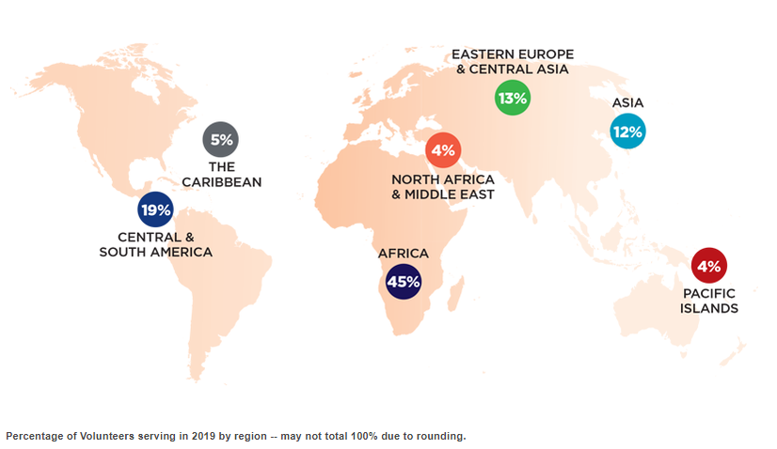
Countries where Volunteers served in 2019:
DESIGN TIP:
Want to change this chart?
Click the chart icon inside the gray picture frame and select a new chart type from the popup menu that appears.
Update your data in the Excel chart that appears above the new chart template.
Notes:
Peace Corps has been in 142 countries historically!
Show them where your country is on the map.
Interactive ideas:
Have them guess where the country is located.
Ask them if they have any knowledge of the country or region.
Share what you thought when you first heard you were going to that country.

Slide 11
DESIGN TIP:
Want to change this chart?
Click the chart icon inside the gray picture frame and select a new chart type from the popup menu that appears.
Update your data in the Excel chart that appears above the new chart template.
Notes:
Show this video as a summary of what they have learned about the Peace Corps.

Slide 12
Country of Service
Add a map of your country here and try to highlight your placement on the map
Notes:
Provide some information about your host country. This could include facts like population and landmass (compare with a state in the USA, i.e., Mali is about the same size as Texas), average per capita income in US dollars, and other facts you think make your country unique. Be sure to use statistics only from reliable sources.
Feel free to add photos of your experience. Whenever possible, use references the audience knows already.

Slide 13
Arrival in Country
Add a photo of your own or from the multimedia library
Notes:
This slide focuses on arrival. Remember that information about Peace Corps is on the website but your story is unique to you.
“When I first got off the plane, I will never forget my first impressions”: Sight, smell, sound, emotion! Talk about first impressions of the country.

Slide 14
Training
Add a photo of your own or from the multimedia library
Notes:
Talk about learning a language or skill, or living with a host family.
This is a great time to talk about that sensitive training experience, “During training, my host family was amazing” and/or “I learned _____ about the culture, got a handle on the language, and learned _______ skills to use in my community.”
Talk about your ‘cross cultural moment’ from training. Think of a moment when you had an amusing cultural gaffe, or when your host family made you feel welcome and share a brief story about it.
*Tip: Be sensitive to your audience! They may be uncomfortable talking about bathroom stories, butchering meat, etc.

Slide 15
My Community
Add a photo of your own or from the multimedia library
Notes:
Describe your site and show pictures of your home. Was it remote, cold, beautiful, huge, tiny, etc.
Did you take a video of your home? Take them on a tour!

Slide 16
Locally-prioritized Projects
Add a photo of your own or from the multimedia library
Notes:
Talk about working with the community, projects you started, completed, or continued.
Talk about your coworkers, counterparts, or students, and your working relationship.
What are you most proud of? What was the most challenging? What surprised you?
*Tip: Remember to talk about how you partnered with host country nationals on important projects, and avoid any language that may sound like you were there to “save” anyone.

Slide 17
Culture
Add a photo of your own or from the multimedia library
Notes:
Elements of Culture: Talk about elements of the culture that interested you and how you learned about them. These elements could include food, dress, weddings, funerals, other ceremonies, relationship to currency, communal nature, the role of the sexes, attitude towards time, play and games, dance and music, the role of elders, or transportation.
Day in the Life: Consider sharing a day in the life of a typical community member. You can add more slides here to further explain the culture and your experience.

Slide 18
A Challenge I Overcame
Add a photo of your own or from the multimedia library
Notes:
Share a story of a struggle or challenge that you faced during your service, and how you overcame it. Make your service relatable to your audience by sharing what was difficult, or a culture shock that you experienced.
*Tip: Remember though to be respectful of your host country’s culture and make sure that any stories you share are appropriate for your audience.

Slide 19
A Success Story
Add a photo of your own or from the multimedia library
Notes:
Share a story of something that you feel proud of, or highlight someone from your community who was doing great things!
*Tip: Remember that success stories do not only have to be about you and your work, they could also be about people that you met in your host community.

Slide 20
Video
Reach out to a counterpart and ask them to record a short video message! Or insert a video from your service.

Slide 21
Activity
DESIGN TIP:
Want to change this image?
The background image on this slide is located on the Slide Master Page.
The Peace Corps has provided a selection of Section Title Slide images to choose from.
Select “Slide Master” from the “View” tab menu at the top of your screen and choose from one of the options provided.
21
Notes:
Teach the class a game, a language lesson, do a craft, etc. Share some food, or do an intercultural activity from your own experience or from the Educator Resource page: https://www.peacecorps.gov/educators/resources/. Our database of resources and lesson plans are searchable by topic, country, and age or audience.

Slide 22
Questions
Notes:
Be sure to leave plenty of time for questions (approximately 1/3-1/2 of your total time). Let their interest drive the conversation.
If you have a shy group, have some of your own questions and answers ready to fill in or some other activities to share. See below for some ideas on questions to have ready to ask and answer.
Some questions to consider and prepare in case students feel shy. Have these questions written on pieces of paper in a hat to have students pull out and read aloud.
What was your happiest moment?
Who was your host country hero?
What was your favorite food?
What was the most challenging part of your service?
If you had to summarize your service in one word, what would it be?
If you could go back to your Peace Corps country tomorrow, what would you want to do first?
Questions to ask your audience:
What did you learn about (host country)?
What is one thing you would share about Americans with my host country nationals/friend/family?
Do you remember where (host country) is in the world?
Do you have any questions about (host country)?

Slide 23
Find us on all platforms @PeaceCorps PeaceCorps.gov
23
Notes:
Final questions:
Ask the students one thing they will remember about your country of service from this presentation.
Ask them how many of you want to apply to Peace Corps after college.

